Slide 1
C# Basics
Getting started with C#
Console application development

Slide 2
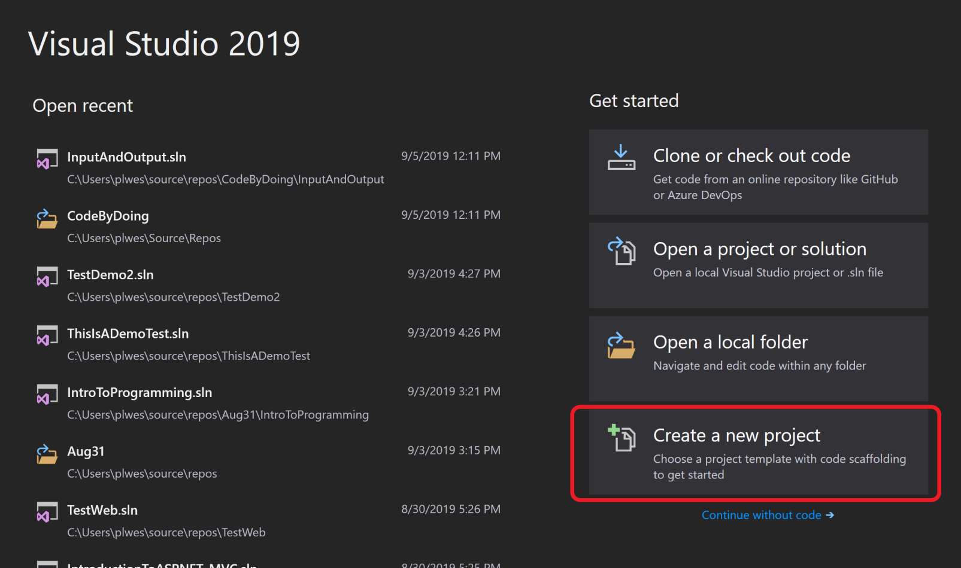
Creating a New Program
Select “Create a new project” from the main menu.

Slide 3
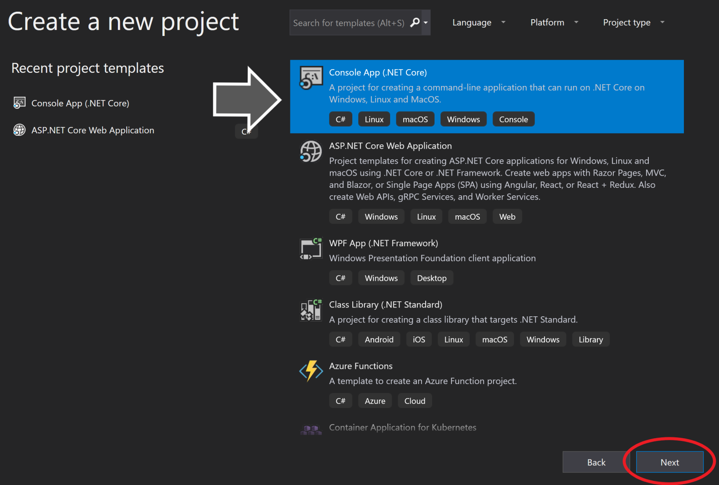
Creating a New Program
Select “Console App (.NET Core)” from the main menu.

Slide 4
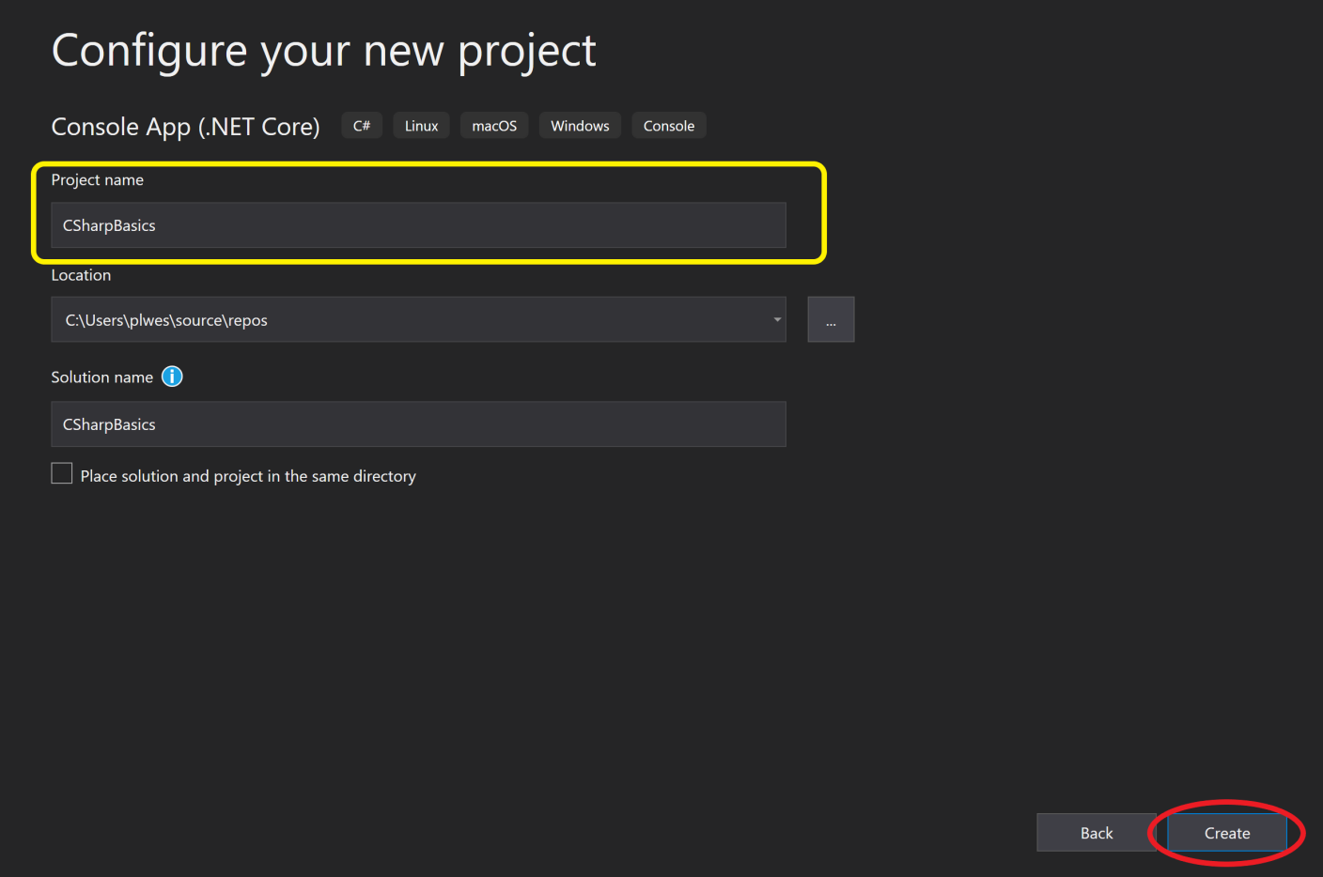
Creating a New Program
Create the project with the following settings:
Project Name: “CSharpBasics”
Location: “default” (i.e. Do not change this setting)
Solution Name: “default” (i.e. Do not change this setting)

Slide 5
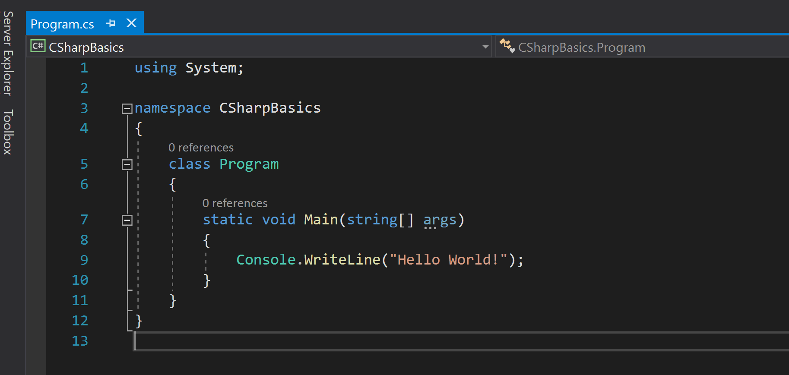
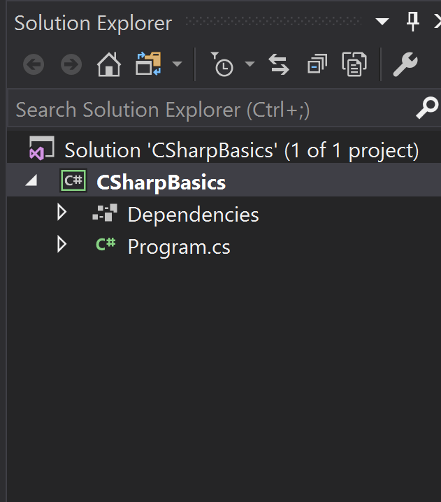
Initial Program Startup
The initial Console Application Statup is quite basic. It consists of only a Program.cs file that has the main entry point of ALL applications:
static void Main(string[] args){}

Slide 6
static void Main(string[] args){}
As mentioned, this is the starting point for ALL .Net applications. When we run a program anywhere within .Net this is the “entry” point for the application. Whether we run the program from the IDE, from the file explorer (by double clicking the .exe file), or from the Command Line; ALL applications will start here.

Slide 7
First things First - Namespaces
Namespaces are used in C# to organize and provide a level of separation of codes. They can be considered as a container which consists of other namespaces, classes, etc. A namespace can have following types as its members: Namespaces (Nested Namespace)

Slide 8
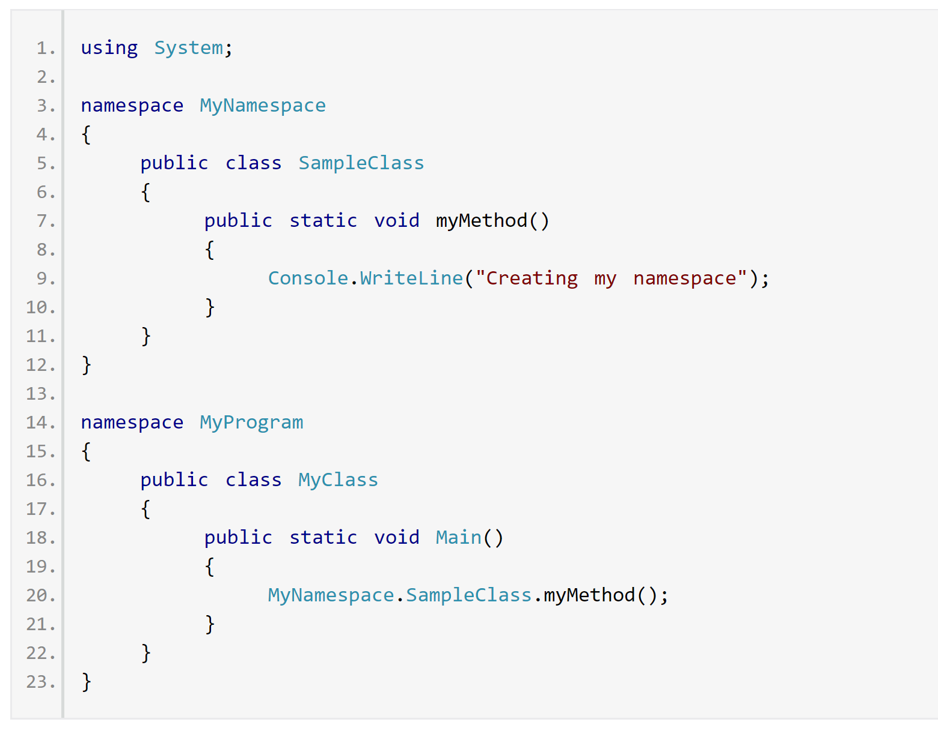
How namespaces are used
In the above example, we have two different namespaces to organize our code. Within the “MyProgram” namespace, we have to use the namespace associated with “MyNamespace” if we want to access the items within the “MyNamespace” area.
Example: MyNamespace.SampleClass.myMethod();

Slide 9
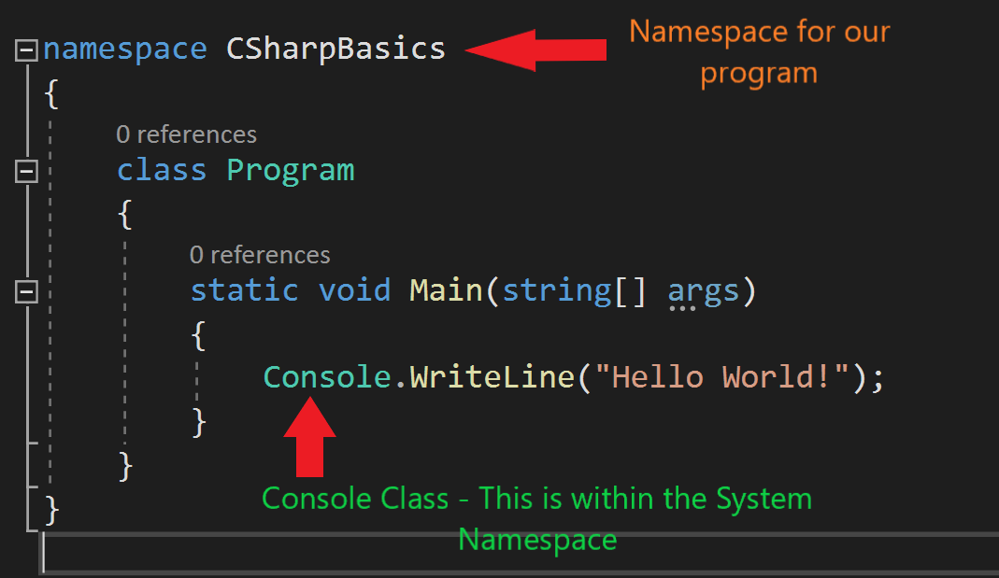
How namespaces are used
In our application, a namespace with the same name as our application is created. This is to ensure that it is separate from anything else in the .Net world. We are using the Console Class that exists within the System Namespace.

Slide 10
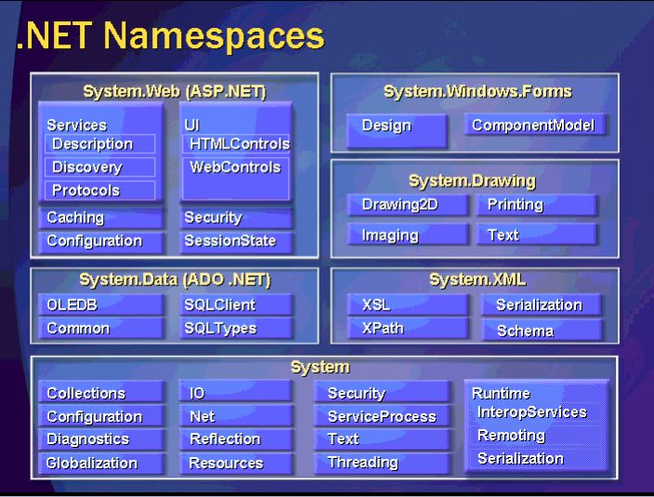
.Net Namespaces
These are some of the common Namespaces in .Net
For example, to utilize the Configuration Namespace in .Net,
we either utilize a “using System;” at the top of our file, or call the methods directly with “System.Configuration…”

Slide 11
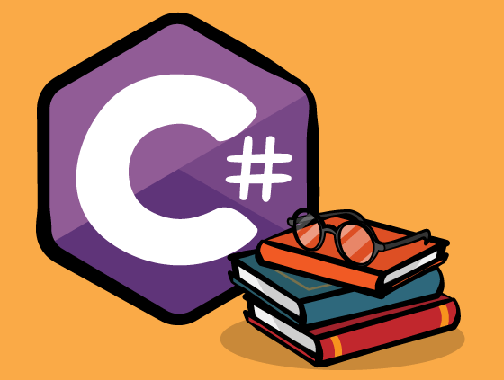
Time to Do Some Work!

Slide 12
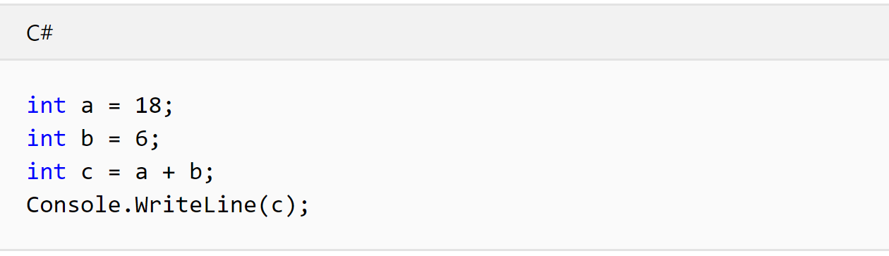
Integer Math
The above code creates two integer variables. One is named a and the other is named b. After we have created them and given them values, we use them to create another variable called c. The value of c is the addition of a + b.
Finally, we print the results to the Console with Console.WriteLine(c);
Now – Do this yourself in your IDE (Visual Studios)

Slide 13
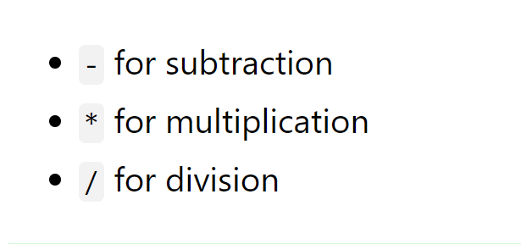
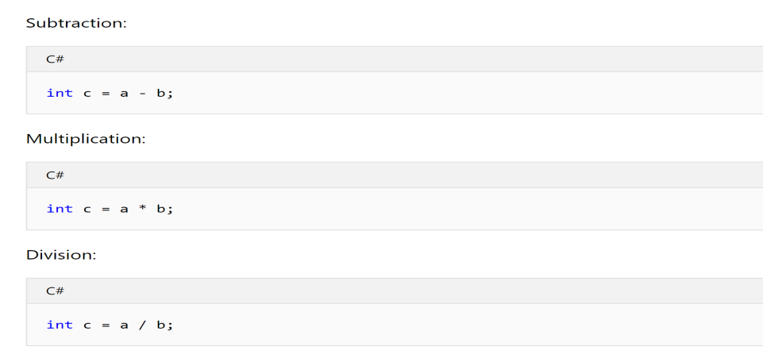
Integer Math
There are many mathematical operations in .Net.
There is also the Math Namespace that has many mathematical methods.

Slide 14
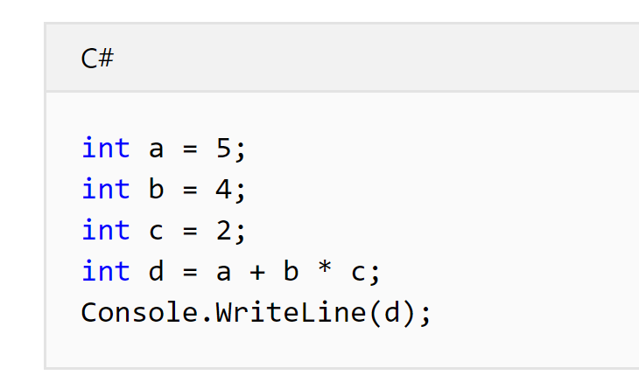
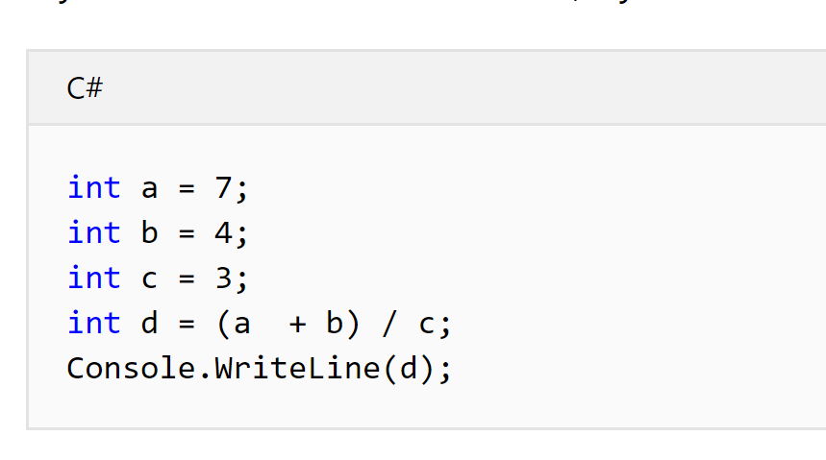
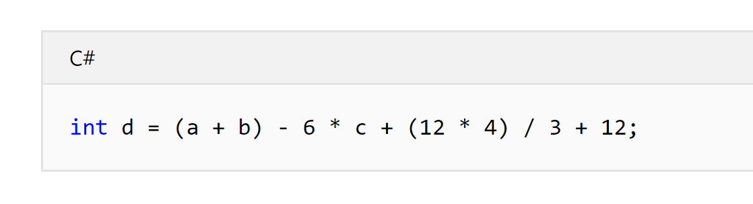
Order of Operations
Try each of these operations in your program and see how the results vary.
Notice that the order of operations is important and follows the same rules as standard Math.

Slide 15
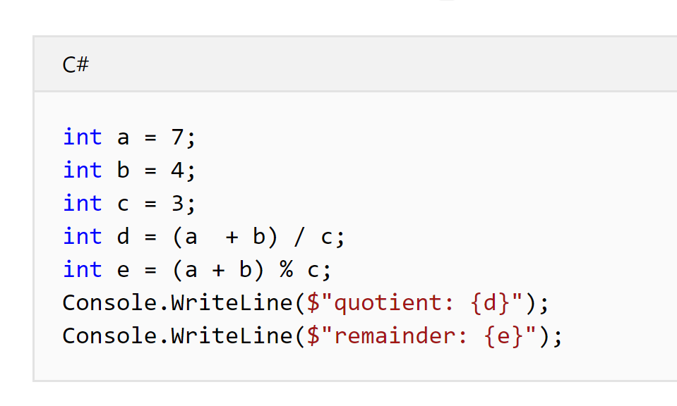
int Variable Type
As before, try this in your application and look at the results.
Notice that with integers we lose all of the “remainder” of a number when we divide. This is because it is an INTEGER. It is a discrete number that throws away all decimal places.

Slide 16
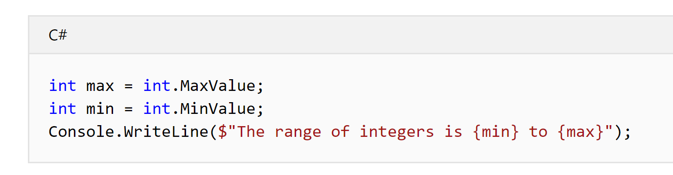
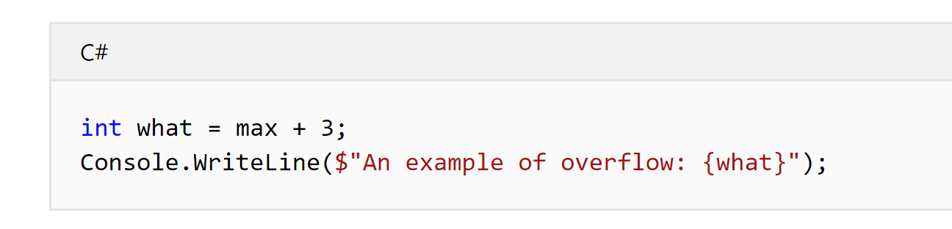
int Precision (How accurate is it)?
The functions “int.MaxValue” and “int.MinValue” are used to get the largest and smallest number for a given numerical variable.
Notice what happens when we try to create a number larger than the “MaxValue”.

Slide 17
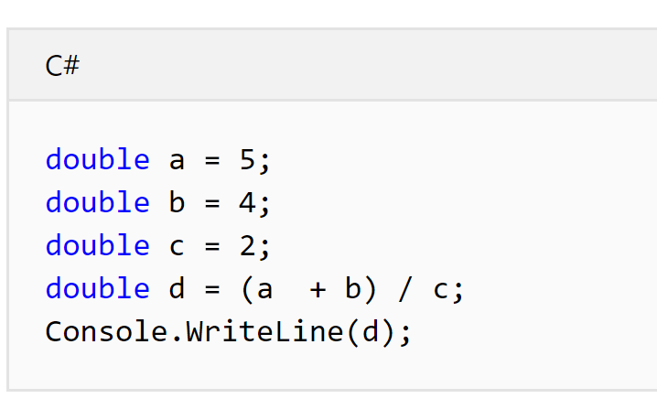
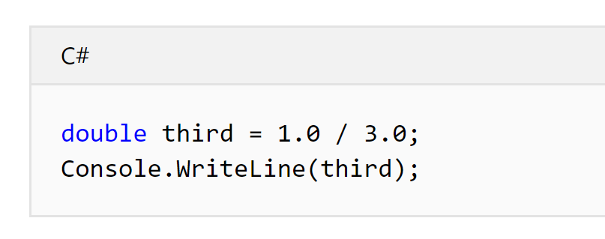
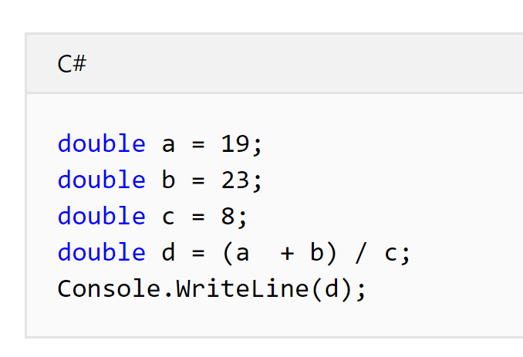
double Variable Type
Just like we did with the “int” variable, let’s do the same with a “double” variable type.
Notice the difference in the results when we use double vs. int.

Slide 18
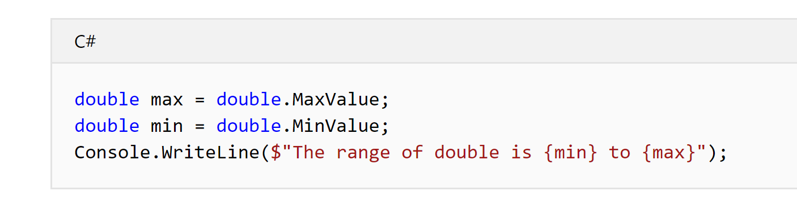
double Precision (How accurate is it)?
Let’s look at the largest and smallest double we can make.
What do you think will happen if we try to create a number larger or smaller than these for a double?
Try it.

Slide 19
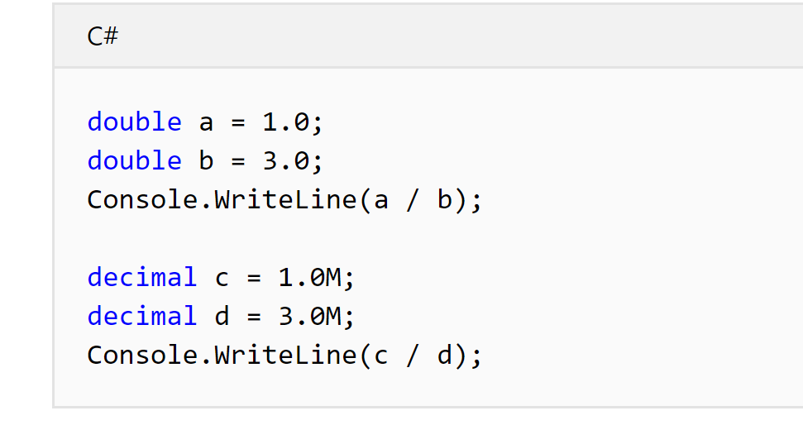
decimal Variable Type
Just like we did with the “int” and “double” variable, let’s do the same with a “decimal” variable type.
The decimal type has a smaller range but greater precision than double.

Slide 20
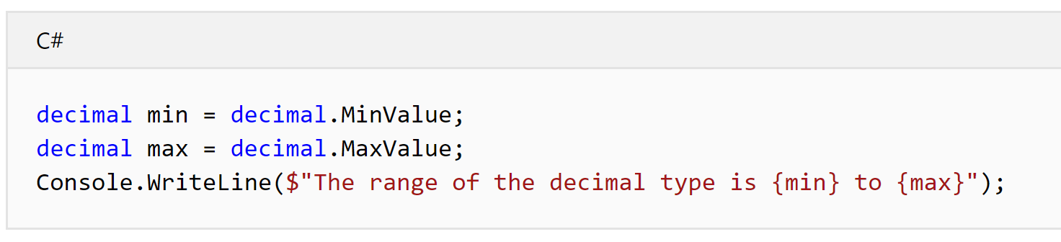
decimal Precision (How accurate is it)?
Let’s look at the largest and smallest decimal we can make.
What do you think will happen if we try to create a number larger or smaller than these for a decimal?

Slide 21
Numbers Challenge
Now that you've seen the different numeric types, write code that calculates the area of a circle whose radius is 2.50 centimeters.
Remember that the area of a circle is the radius squared multiplied by PI.
One hint: .NET contains a constant for PI, Math.PI that you can use for that value.

Slide 22
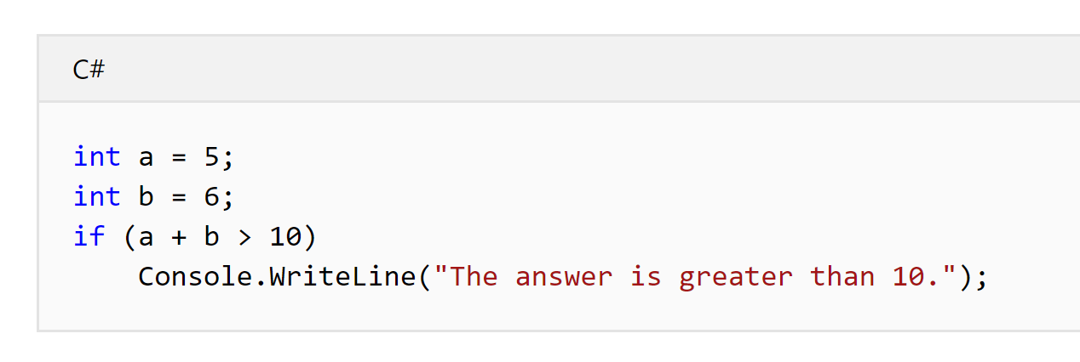
Make decisions using the if statement
This first sample shows the power of “if” and boolean types. A boolean is a variable that can have one of two values: true or false. C# defines a special type, bool for boolean variables. The if statement checks the value of a bool.
When the value is true, the statement following the if executes. Otherwise, it is skipped.

Slide 23
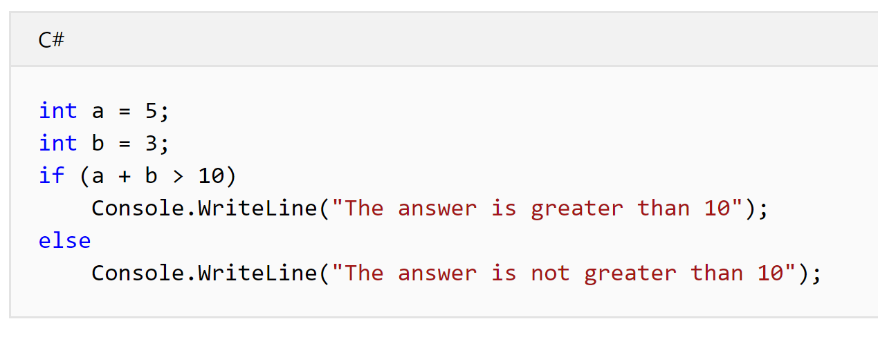
Make decisions using the if and else statement
The statement following the “else” keyword executes only when the condition being tested is false.
Combining “if” and “else” with a “bool” condition provides all the power you need.

Slide 24
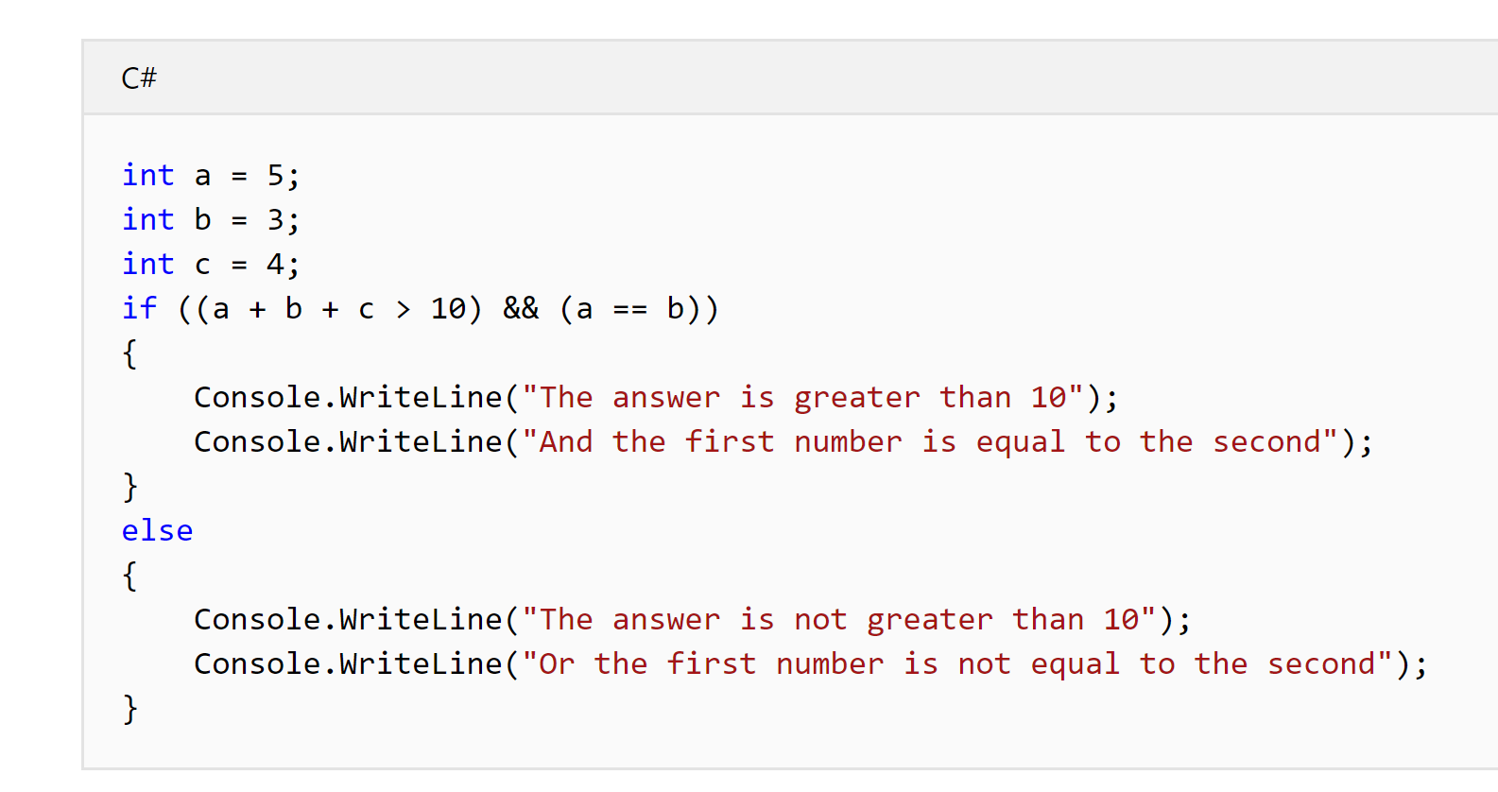
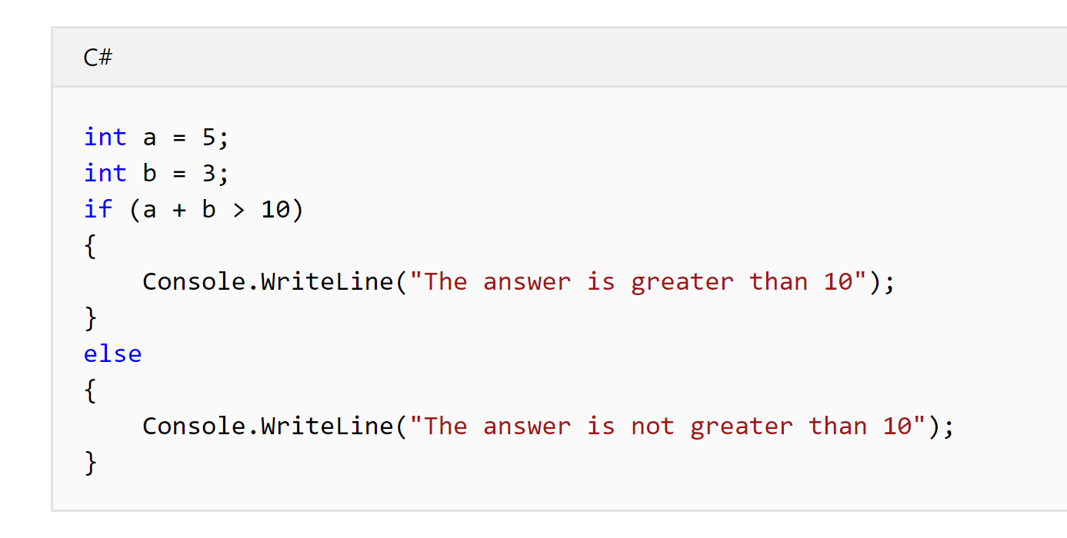
Using { and } with “if” and “else”
Because indentation is not significant, you need to use { and } to indicate when you want more than one statement to be part of the block that executes conditionally.
C# programmers typically use those braces on all “if” and “else” clauses. The following example is the same as what you just created.

Slide 25
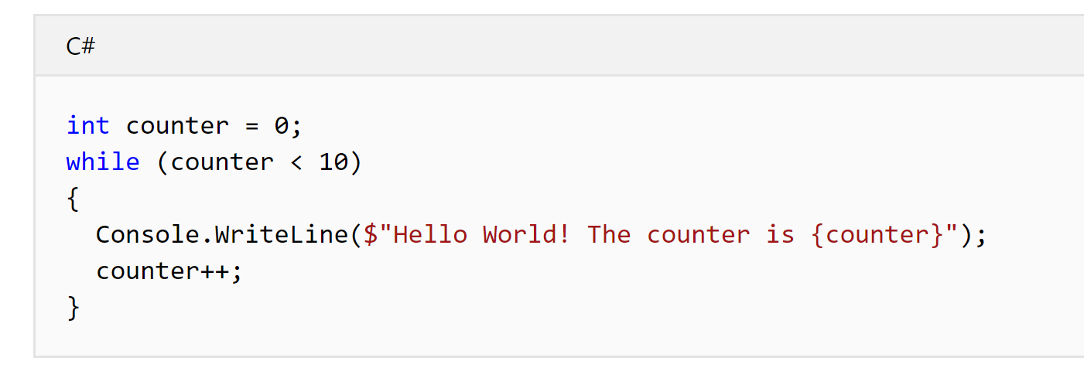
Use “while” to repeat operations
The “while” statement checks a condition and executes the statement following the while. It will repeat checking the condition and executing those statements until the condition is false.
There's one other new operator in this example. The “++” after the counter variable is the increment operator.
It adds 1 to the value of counter, and stores that value in the counter variable.
What do you think the “--“ will do?

Slide 26
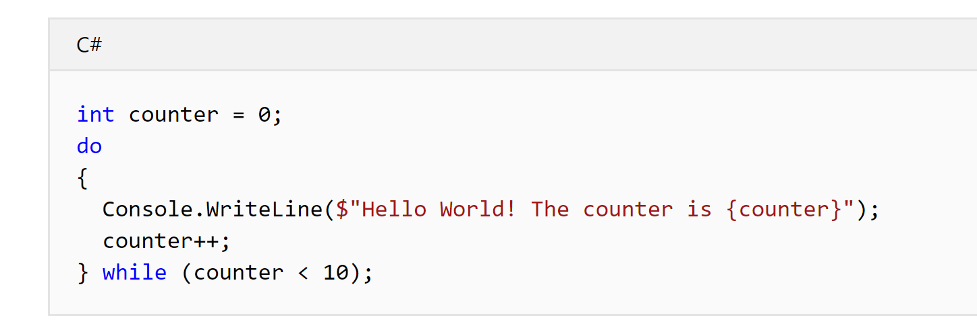
Use “do … while” to repeat operations
The “while” loop tests the condition before executing the code following the while. The “do ... while" loop executes the code first, and then checks the condition.
This “do … loop” and the earlier “while” loop work the same.
When would you want to use a “do … while” loop instead of a regular “while” loop????

Slide 27
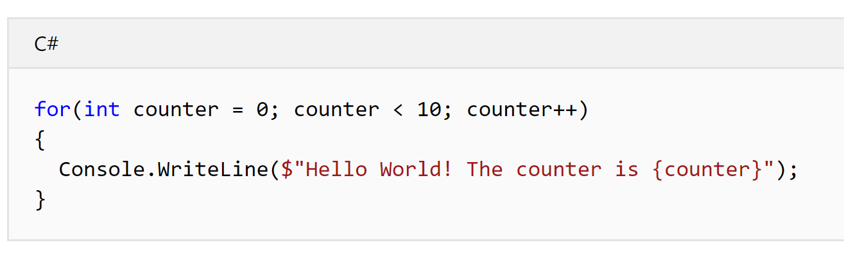
The Magical “for” loop
This does the same work as the “while” loop and the “do … loop” you've already used. The “for” statement has three parts that control how it works.
The first part is the for initializer: int counter = 0; declares that counter is the loop variable, and sets its initial value to 0.
The middle part is the for condition: counter < 10 declares that this for loop continues to execute as long as the value of counter is less than 10.
The final part is the for iterator: counter++ specifies how to modify the loop variable after executing the block following the for statement. Here, it specifies that counter should be incremented by 1 each time the block executes.

Slide 28
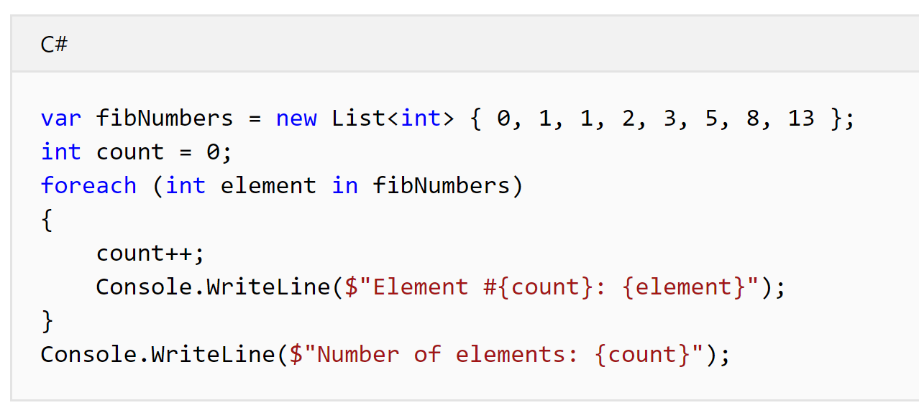
The Super Magical foreach
The “foreach” statement executes a statement or a block of statements for each element in an instance of the type that implements the System.Collections.IEnumerable or System.Collections.Generic.IEnumerable<T> interface.
The “foreach” statement is not limited to those types and can be applied to an instance of any type that satisfies the following conditions:
has the public parameterless GetEnumerator method whose return type is either class, struct, or interface type,
the return type of the GetEnumerator method has the public Current property and the public parameterless MoveNext method whose return type is Boolean.
Basically: It works on ANY “collection”, like a “List<T>”

Slide 29
Logic Challenge
Now that you've seen the if statement and the looping constructs in the C# language, see if you can write C# code to find the sum of all integers 1 through 20 that are divisible by 3. Here are a few hints:
The “%” operator gives you the remainder of a division operation.
The “if” statement gives you the condition to see if a number should be part of the sum.
The “for” loop can help you repeat a series of steps for all the numbers 1 through 20.
Try it yourself. Then check how you did. As a hint, you should get 63 for an answer.

Slide 30
Pseudocode
Pseudocode is a simple way of writing programming code in English.
Pseudocode is not actual programming language.
It uses short phrases to write code for programs before you actually create it in a specific language. Once you know what the program is about and how it will function, then you can use pseudocode to create statements to achieve the required results for your program.

Slide 31
Examples of Pseudocode
Problem: Create a program to add 2 numbers together and then display the result.
Pseudocode:
Start Program Enter two numbers, A, B Add the numbers together Print Sum End Program
It’s really that simple!
Before each challenge, write pseudocode for the challenge.

Slide 32
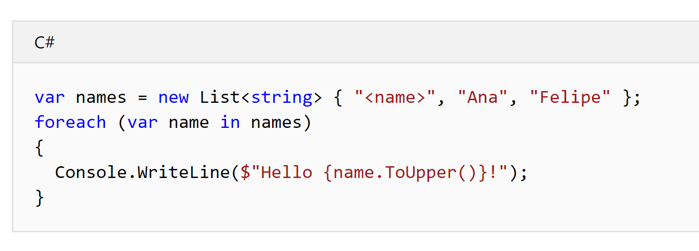
Creating Lists
The collection uses the “List<T>” type. This type stores sequences of elements. You specify the type of the elements between the angle brackets <T>.
This creates a “List<string>” of strings, adds three names to that list, and prints out the names in all CAPS. You're using concepts that you've learned in earlier tutorials to loop through the list.
The code to display names makes use of the string interpolation feature. When you precede a string with the $ character, you can embed C# code in the string declaration. The actual string replaces that C# code with the value it generates.
In this example, it replaces the {name.ToUpper()} with each name, converted to capital letters, because you called the “String.ToUpper” method.

Slide 33
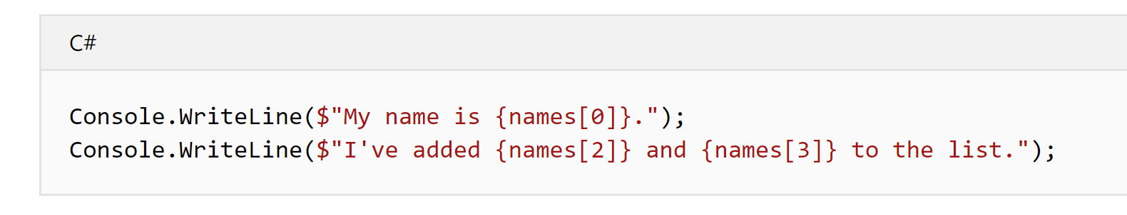
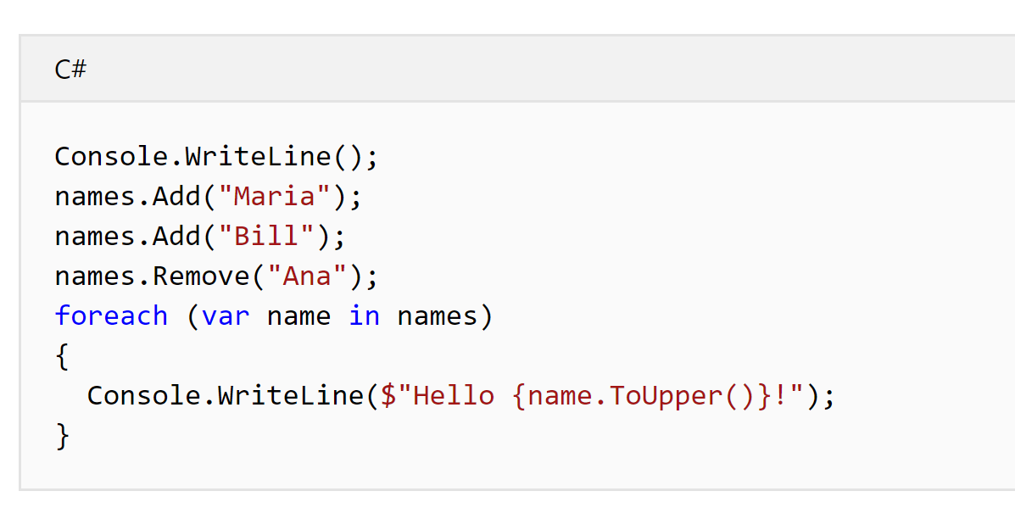
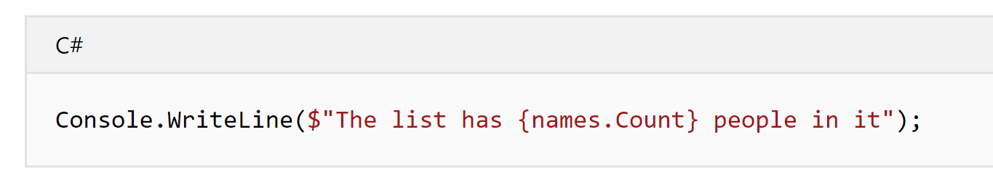
Modifying Lists
One important aspect of this “List<T>” type is that it can grow or shrink, enabling you to add or remove elements. You can see the results by modifying the contents after you've displayed its contents.
The “List<T>” enables you to reference individual items by index as well. You access items using the [ and ] tokens.
You're not allowed to access past the end of the list. You can check how long the list is using the “Count” property.

Slide 34
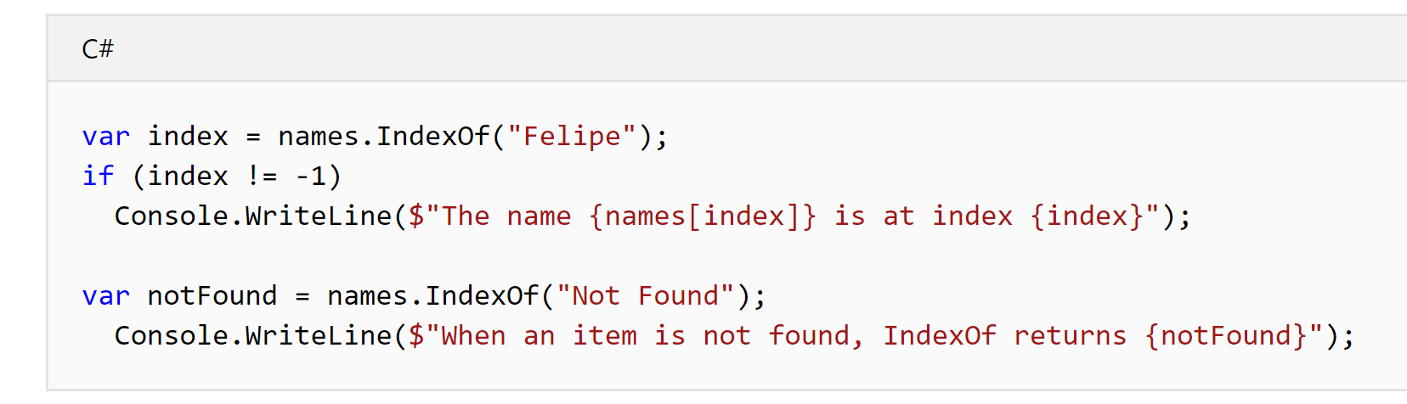
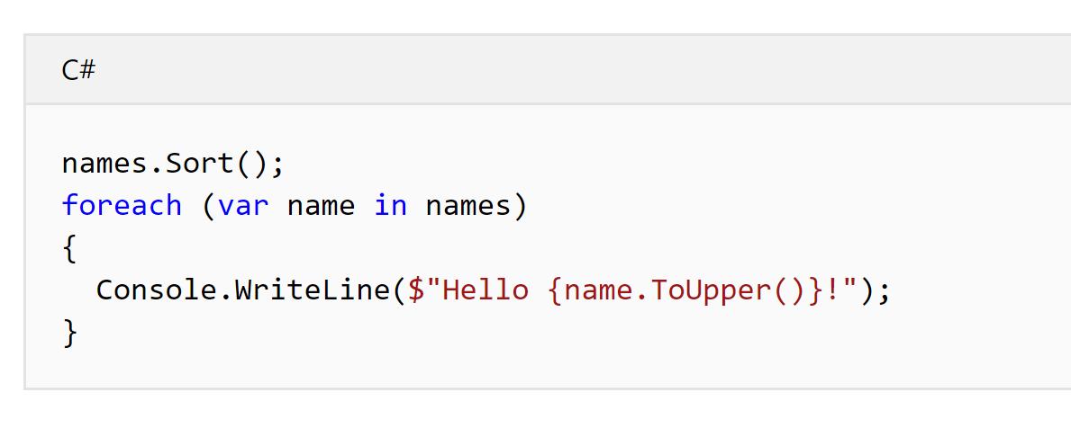
Searching and Sorting Lists
Our samples use relatively small lists, but your applications may often create lists with many more elements, sometimes numbering in the thousands. To find elements in these larger collections, you need to search the list for different items. The “IndexOf[index]” method searches for an item and returns the index of the item.
The items in your list can be sorted as well. The “Sort()” method sorts all the items in the list in their normal order (alphabetically in the case of strings).

Slide 35
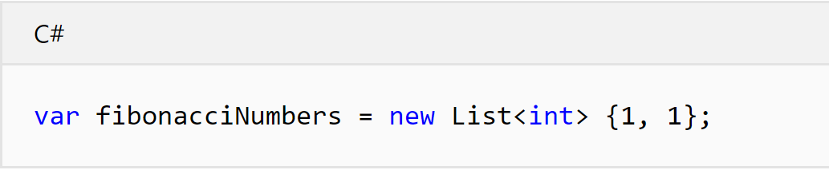
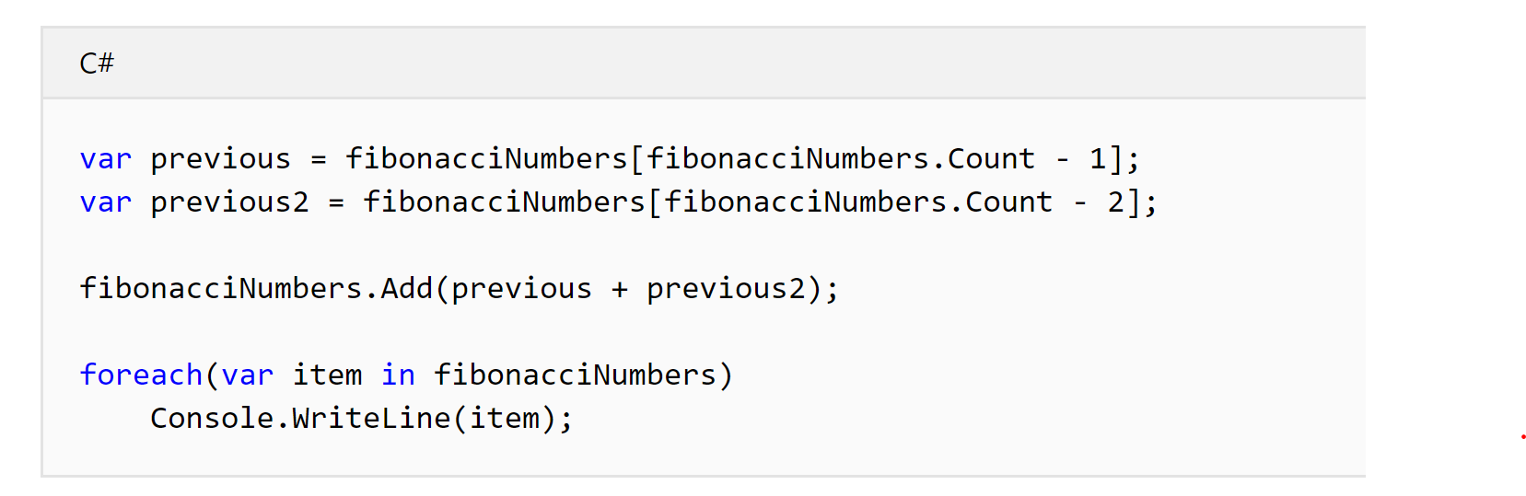
Creating Lists
That creates a “List<int>” of “int”, and sets the first two integers to the value 1.
The Fibonacci Sequence, a sequence of numbers, starts with two 1s.
Each next Fibonacci number is found by taking the sum of the previous two numbers.

Slide 36
Final Challenge
See if you can put together some of the concepts from this and earlier lessons.
Expand on what you've built so far with Fibonacci Numbers. Try and write the code to generate the first 20 numbers in the sequence.
(As a hint, the 20th Fibonacci number is 6765.)

Slide 37
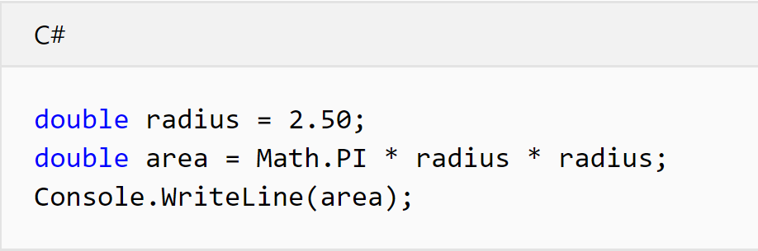
Challenge 1 Answer

Slide 38
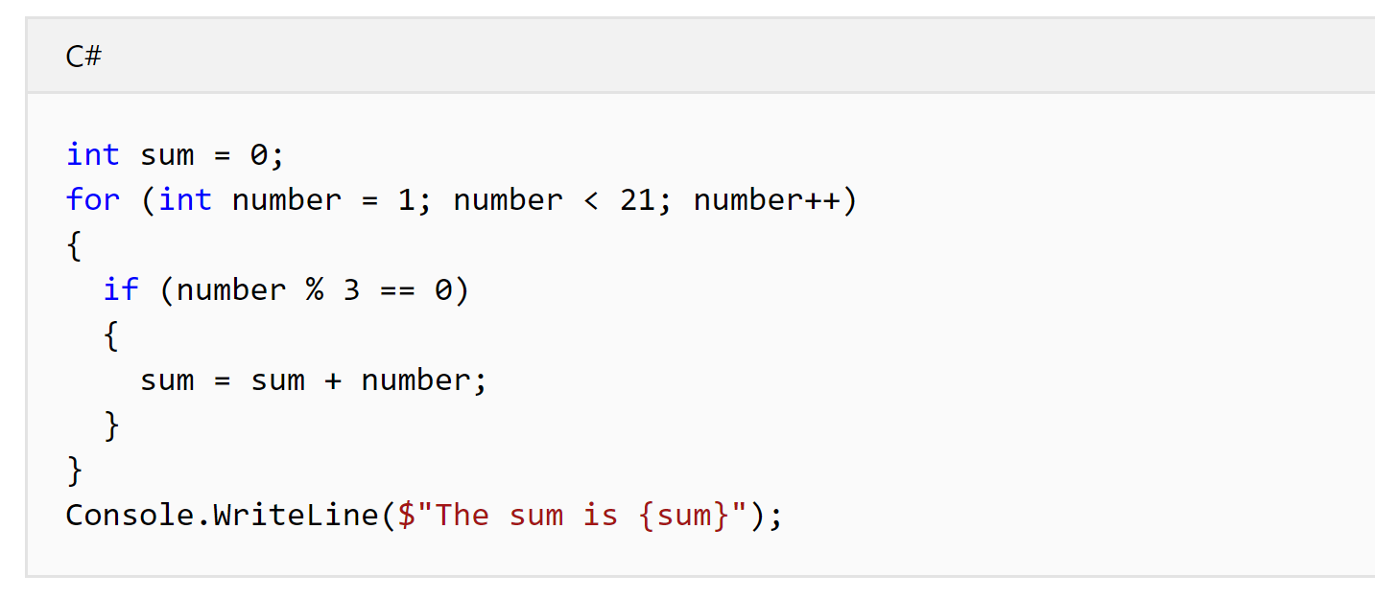
Challenge 2 Answer

Slide 39
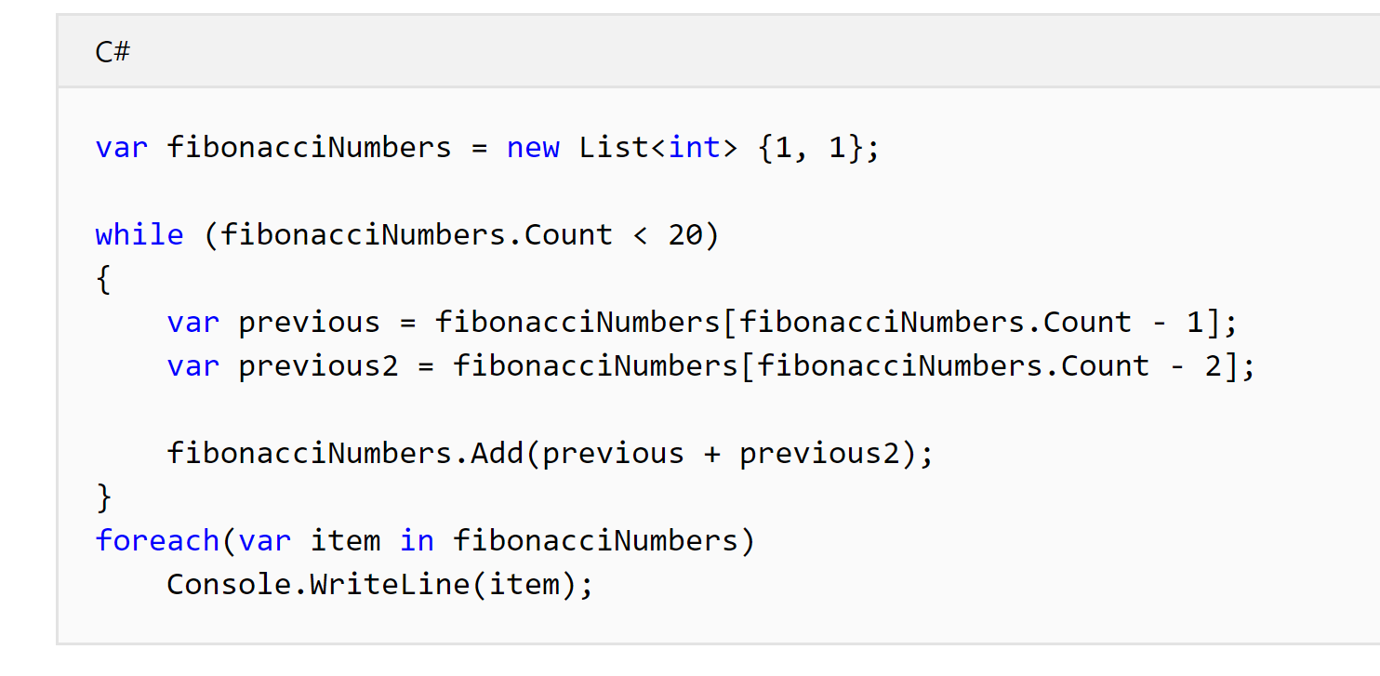
Challenge 3 Answer

Slide 40
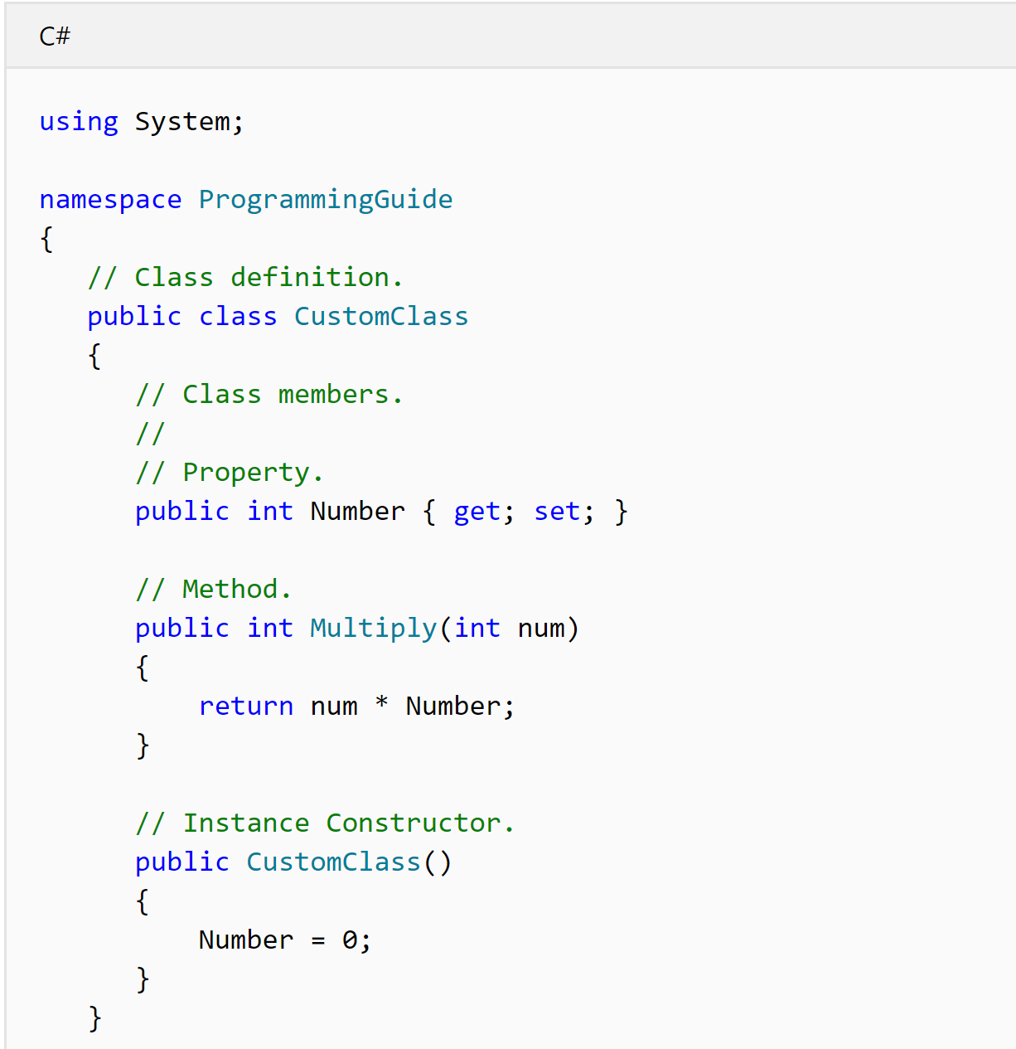
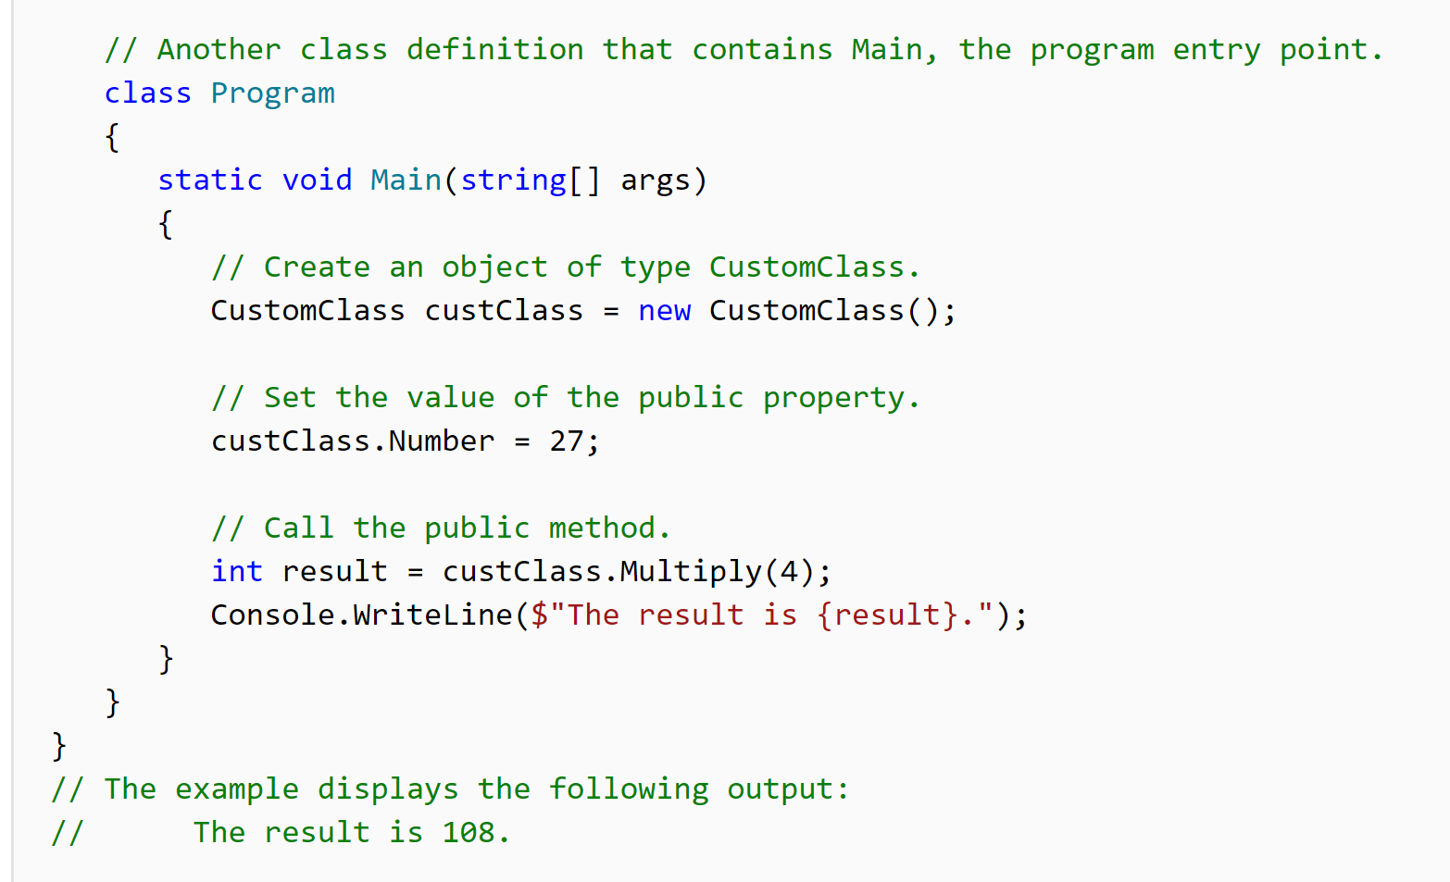
Classes in C#
This is a class. It defines what an “object” is.
This is another class that “uses” the “CustomClass”

Slide 41
Classes in C#
public static void Main(string[] arg){
Console.WriteLine(“Hello World”);
} ;
This “Console.WriteLine()” can be placed inside another class with “methods” and then used in the same way as the previous example.

Slide 42
Classes in C#
The class that will USE the created Class:
public class Program
{
public static void Main(string[] arg)
{
MyClass.WriteAMessage(“Hello World”);
} ;
}
The Class that will be used:
public class MyClass
{
public void WriteAMessage(string message)
{
Console.WriteLine(message);
}
}

Slide 43
Encapsulation
Encapsulation is sometimes referred to as the first pillar or principle of object-oriented programming.
According to the principle of encapsulation, a class or struct can specify how accessible each of its members is to code outside of the class or struct.
Methods and variables that are not intended to be used from outside of the class or assembly can be hidden to limit the potential for coding errors or malicious exploits.

Slide 44
Members
All methods, fields, constants, properties, and events must be declared within a type; these are called the members of the type(class).
In C#, there are no global variables or methods as there are in some other languages. Even a program's entry point, the Main method, must be declared within a class or struct.
The following list includes all the various kinds of members that may be declared in a class or struct.
Fields Constants
Properties Methods
Constructors Events
Finalizers Indexers
Operators Nested Types

Slide 45
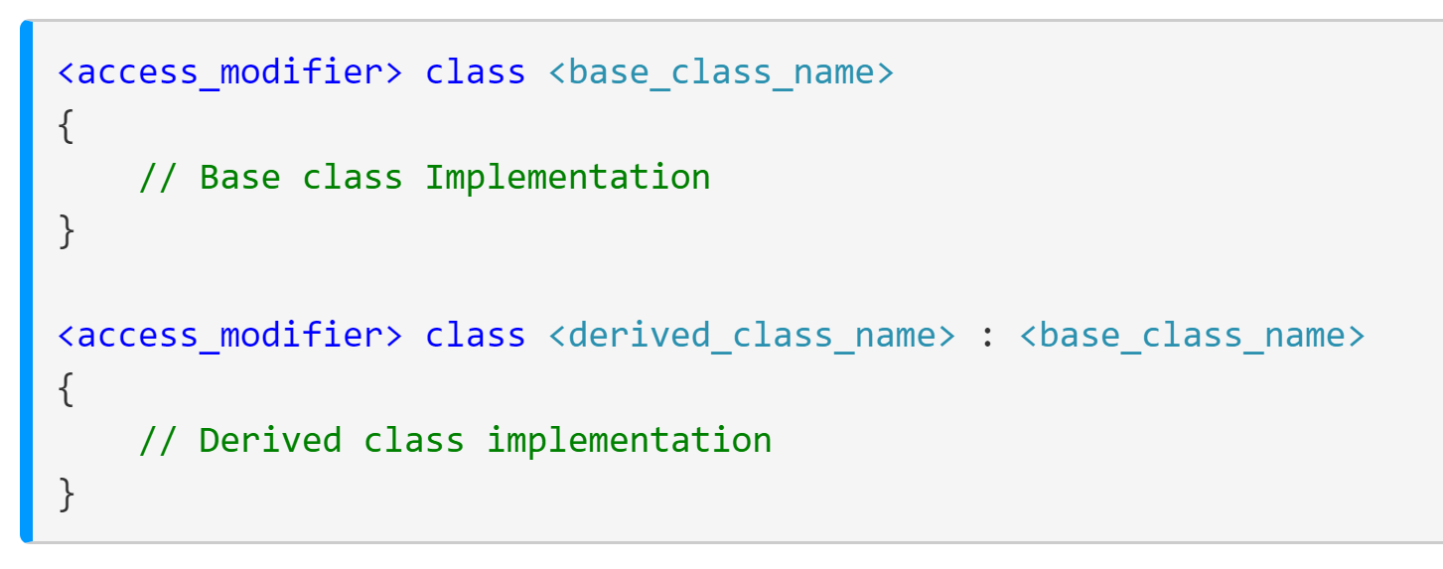
Inheritance
Inheritance enables you to create new classes that reuse, extend, and modify the behavior that is defined in other classes.
The class whose members are inherited is called the base class, and the class that inherits those members is called the derived class. A derived class can have only one direct base class.
However, inheritance is transitive. If ClassC is derived from ClassB, and ClassB is derived from ClassA, ClassC inherits the members declared in ClassB and ClassA.

Slide 46
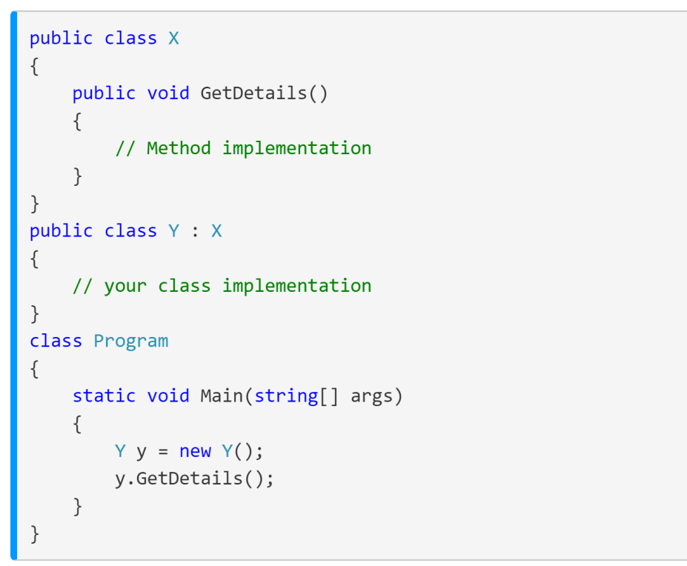
Inheritance
Anything created in “X” that is not private, can be used even if you create an object of type “Y”.
This allows us to write code once, and use it many times.
Consider how we could use inheritance for something like Animals.

Slide 47
Inheritance Example (Animals)
using System;
namespace InheritanceExample
{
public class Animal
{
public void Sleep()
{
Console.WriteLine(“Sleep");
}
public virtual void MakeNoise()
{
Console.WriteLine(“SomeNoise");
}
public abstract void DoAction();
}
using System;
namespace InheritanceExample
{
class Dog : Animal
{
public override void MakeNoise()
{
Console.WriteLine("Woof Woof");
}
public void DoAction()
{
Console.WriteLine(“Dig Hole”);
}
}
class Cat : Animal
{
public override void MakeNoise()
{
Console.WriteLine("Meaaooooow");
}
public void DoAction()
{
Console.WriteLine(“Climb Tree”);
}
}
}

